Slide 1
ECE 5397/6397:
Introduction to Robotics
Lecture 14:
Manipulator singularities
Reference: Chapter 4.9, RD&C
Instructor: Aaron Becker

Slide 2
Welcome!
My lab is submitting robotics conference papers on Sunday. Submitting a quality conference paper is a requirement for an MS degree in my lab. If you’d like to proofread a conference paper and give feedback, let me know.

Slide 3
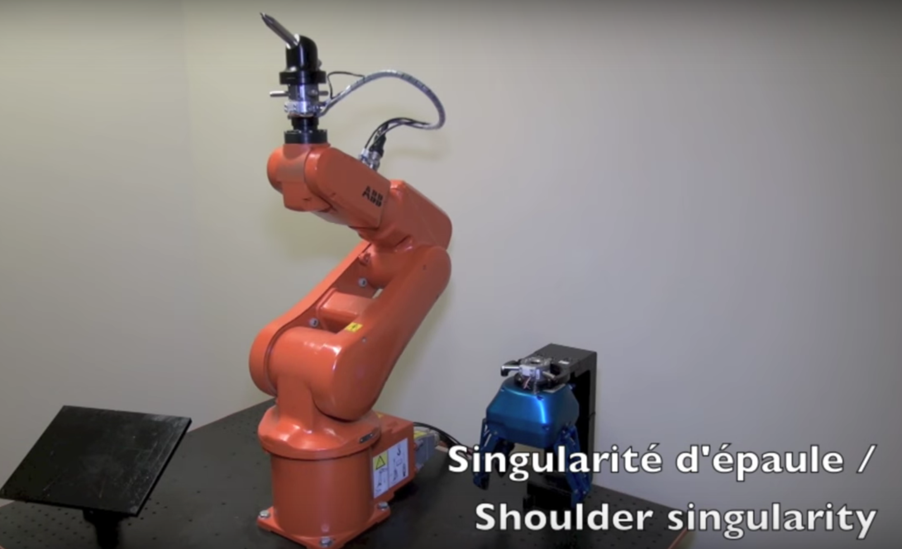
Video on singularities
https://youtu.be/zlGCurgsqg8
More info at http://robohub.org/3-types-of-robot-singularities-and-how-to-avoid-them/
Notes:
Singularities are caused by the inverse kinematics of the robot. When placed at a singularity, there may be an infinite number of ways for the kinematics to achieve the same tip position of the robot. If the optimal solution is not chosen, assuming there is one, the robot joints could be commanded to move in an impossible way. Infinite velocity is not the only type of singularity that causes problems and certain types of singularities can be more problematic than others. Some robots can be put in such a bad position that they need to be turned off, moved, and restarted manually.

Slide 4
What are we doing?

Slide 5
Inverse
Notes:
In linear algebra, the adjugate of a square matrix is the transpose of its cofactor matrix.
Do a problem on the board

Slide 6
Inverse
Notes:
In linear algebra, the adjugate of a square matrix is the transpose of its cofactor matrix.
Do a problem on the board

Slide 7
Determinants
Notes:
There are various equivalent ways to define the determinant of a square matrix A, i.e. one with the same number of rows and columns. Perhaps the simplest way to express the determinant is by considering the elements in the top row and the respective minors; starting at the left, multiply the element by the minor, then subtract the product of the next element and its minor, and alternate adding and subtracting such products until all elements in the top row have been exhausted. For example, here is the result for a 4 × 4 matrix:

Slide 8
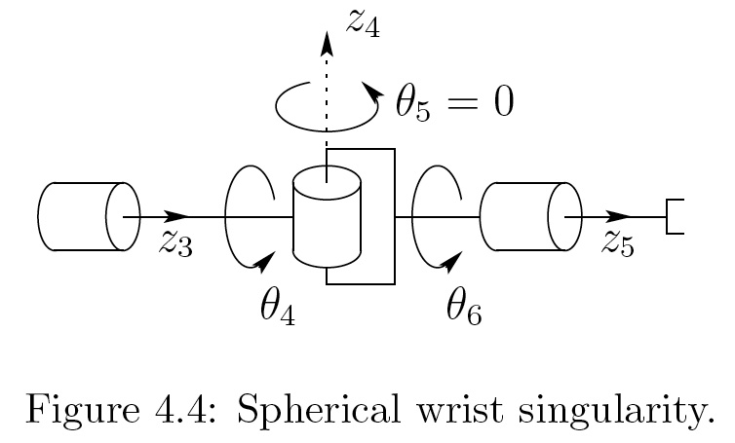
Example 1

Slide 9
Trick: decouple arm & wrist singularities

Slide 10
Make d₆=0
Notes:
J_22 = -c_4^2 s_5 + s_4^2 s_5
When z_3 and z)5 are collinear, we are singular. When any two joint axis are collinear, this occurs (equal and opposite rotation about the axis results in no net motion.

Slide 11
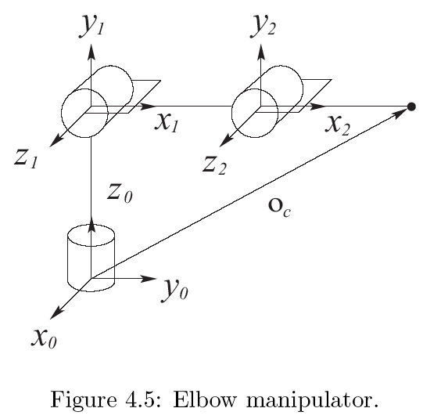
04_05
04_05
Notes:
Two options. Draw them both on board
04_05.jpg

Slide 12
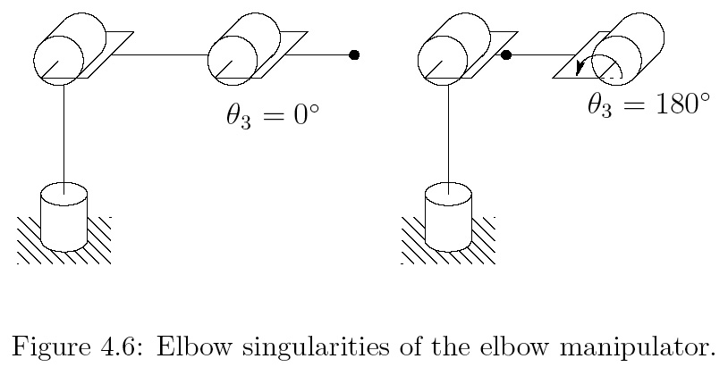
θ₃=π or 0

Slide 13
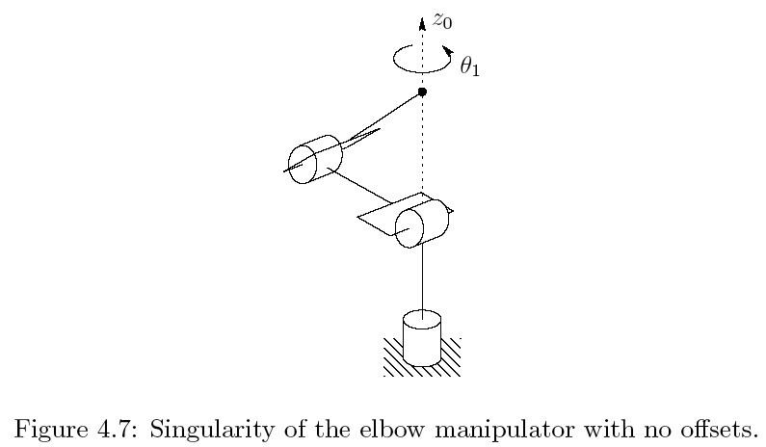
04_07
04_07
Notes:
04_07.jpg

Slide 14
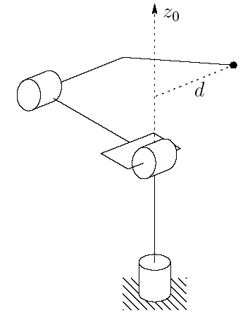
04_08
04_08
Notes:
Here we added a d2 and a d3
04_08.jpg

Slide 15
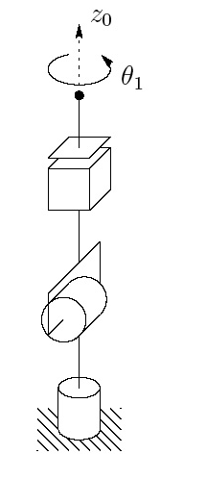
Spherical Manip
Notes:
----- Meeting Notes (3/3/16 12:55) -----
work out by hand

Slide 16
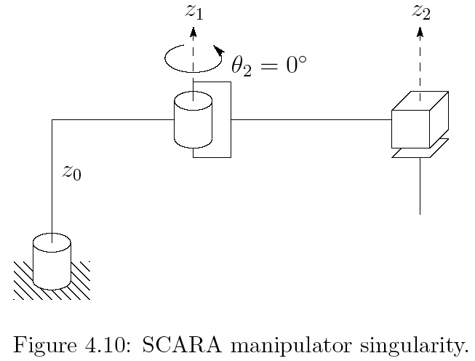
04_10
04_10
Notes:
04_10.jpg

Slide 17
SCARA
Notes:
----- Meeting Notes (3/3/16 12:55) -----
fix the r2 values. previous, expand left column

Slide 18
SCARA answer
Notes:
----- Meeting Notes (3/3/16 12:55) -----
what is the trig identity

Slide 19
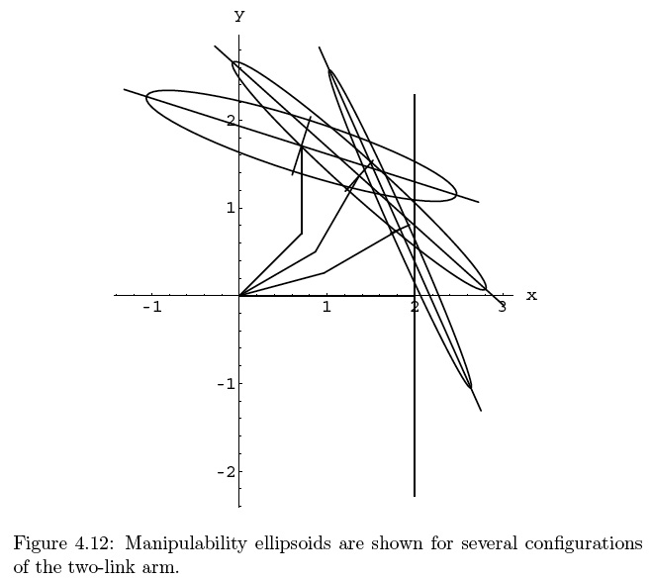
04_12
04_12
Notes:
04_12.jpg

Slide 20
For the Next Class
Study Read 11.1-11.3 for Lecture 15

Slide 21
In class worksheet

